Slide 1
DATA 110: DATA VISUALIZATION & COMMUNICATION
Academic Research Report
Global Video Game Commercial Trends & Regional Dynamics
An evidence-based exploration of genre dominance, historical sales cycles, and global consumer preferences.
AUTHOR
Christian Tabuku
16,500+ Titles
4 Decades Analyzed

Slide 2



FRAMEWORK
Research Scope & Core Questions
Key analytical pillars driving the global industry breakdown
16,500+ Title Scope
Genre Heavyweights
Regional Divergence
Historical sales tracking global game performance from 1980 to 2020.
Identifying long-term commercial leadership across major gaming categories.
Comparing purchasing habits across North America, Europe, and Japan.

Slide 3
VISUALIZATION 01
Action & Sports Lead Global Sales Volume
Total cumulative units sold across top 5 categories worldwide (in millions)
Action
1,750M
Sports
1,330M
Shooter
1,030M
Role-Playing
930M
Platform
830M

Slide 4
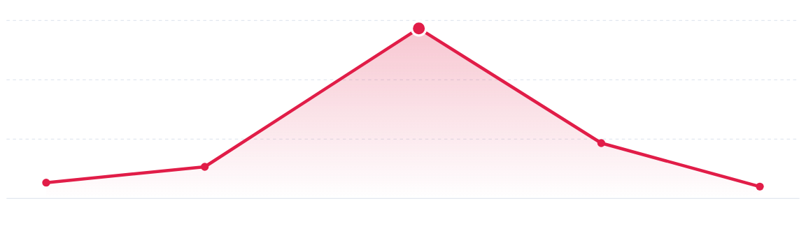
VISUALIZATION 02
678M Unit Peak During the 2008 Console Era
Global sales surge driven by widespread adoption of Wii, PS3, and Xbox 360 hardware
2008 Peak (678M Units)
1980
1995
2008
2012
2020

Slide 5

VISUALIZATION 03
Japan Outpaces Western Markets in RPG Preference
Comparing unit sales (in millions) across major regional markets by top categories
NORTH AMERICA
Europe
Japan
Action (870M) and Sports (680M) command major market volume.
North America
EUROPE
Balanced distribution across Action (520M) and Sports (370M).
JAPAN
Role-Playing games (350M) outperform all other genres locally.
Action
Platform
Role-Playing
Shooter
Sports

Slide 6
CONCLUSIONS
Core Analytical Takeaways
Strategic lessons derived from global software distribution trends
01
02
03
Western Volume Alignment
Hardware Cycle Drivers
Regional Tailoring
Action and Sports titles maintain global dominance due to high Western adoption.
Physical retail peaked during the 2008 console era before digital market shifts.
Japanese preferences demand specialized RPG focus compared to US and EU markets.

Slide 7

Thank You
Questions & Discussion

